Slide 1
Hash tables
Project by:
Neha Prakash-1BM16IS003

Slide 2
introduction
Hashing is a technique that is used to uniquely identify a specific object from a group of similar objects. Some examples of how hashing is used in our lives include:
In universities, each student is assigned a unique roll number that can be used to retrieve information about them.
In libraries, each book is assigned a unique number that can be used to determine information about the book, such as its exact position in the library or the users it has been issued to etc.

Slide 3
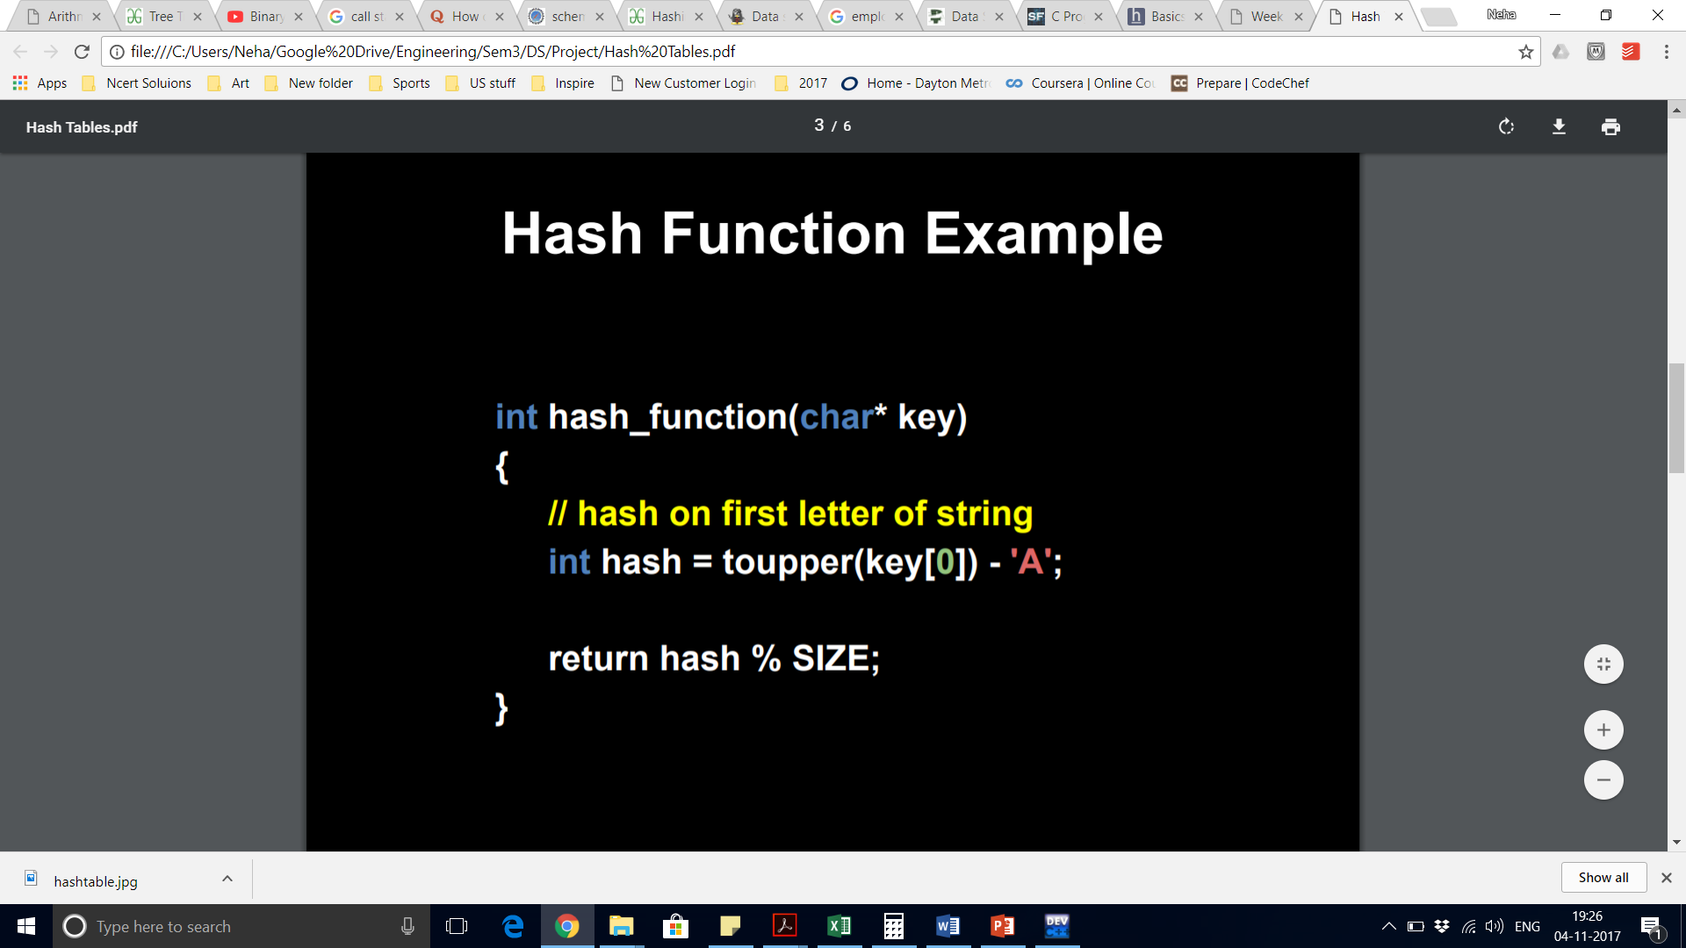
Hash function
A hash function is any function that can be used to map a data set of an arbitrary size to a data set of a fixed size, which falls into the hash table.
Ex: A C program could just use the ASCII value, but subtract 65 from a capital A, or 97 from a lowercase a, so we can place them in buckets starting from 0.

Slide 4
A Good hash function
Use only the data being hashed
Use all of the data being hashed
Be deterministic
Uniformly distribute data
Generate different hash codes for different data

Slide 5
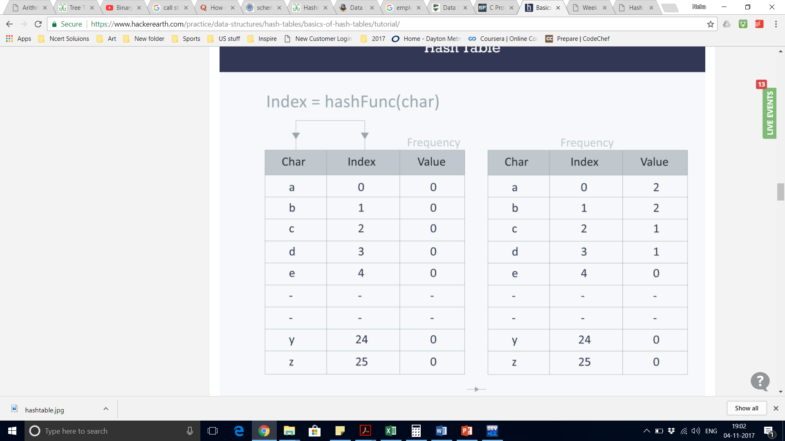
Hash table
A hash table is a data structure that is used to store keys/value pairs. It uses a hash function to compute an index into an array in which an element will be inserted or searched. By using a good hash function, hashing can work well. Under reasonable assumptions, the average time required to search for an element in a hash table is O(1).

Slide 6
Why Hash?
Hash tables combine the random access ability of an array with the dynamism of a linked list
This means, insertion, deletion and search can start to tend to O(1) (constant time)
We are gaining the advantages of both types of data structures while mitigating the disadvantages
The trade off is that hash tables are not great at ordering or sorting data

Slide 7
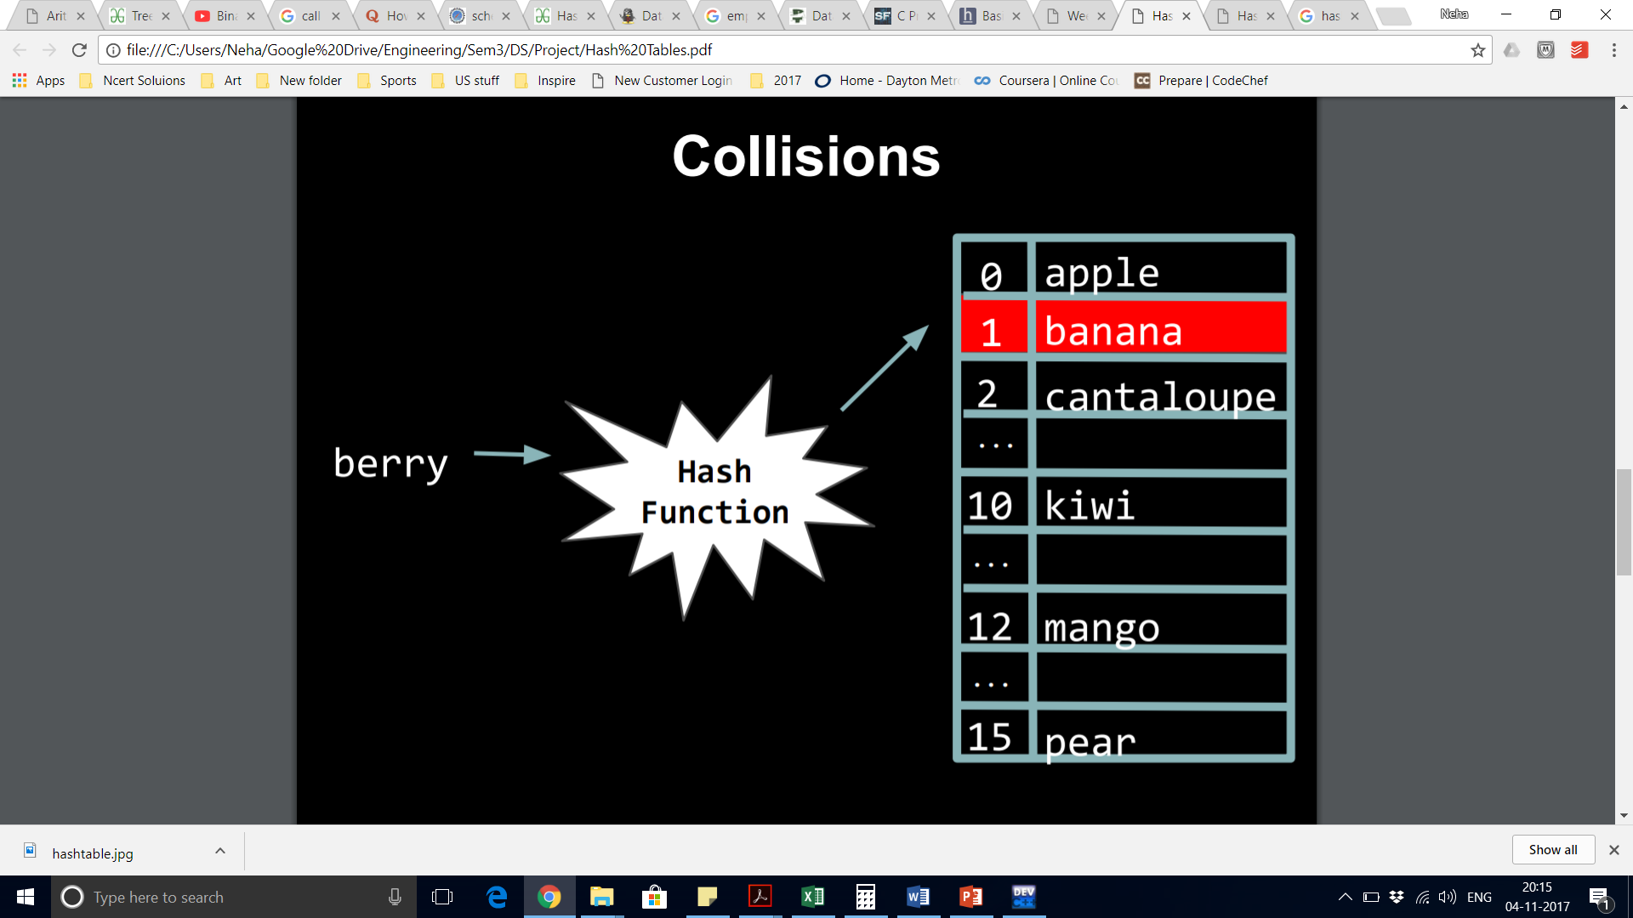
Collision
A collision occurs when two pieces of data, when run through the hash function, yield the same hash code.
Presumably we want to store both pieces of data in the hash table, so we shouldn’t simply overwrite that happened to be placed there first.
We need to find a way to get both elements into the hash table while trying to preserve the quick insertion and search

Slide 8
Collision resolution techniques
Separate chaining
Linear probing
Quadratic probing
Double hashing
Rehashing
Extendible hashing

Slide 9
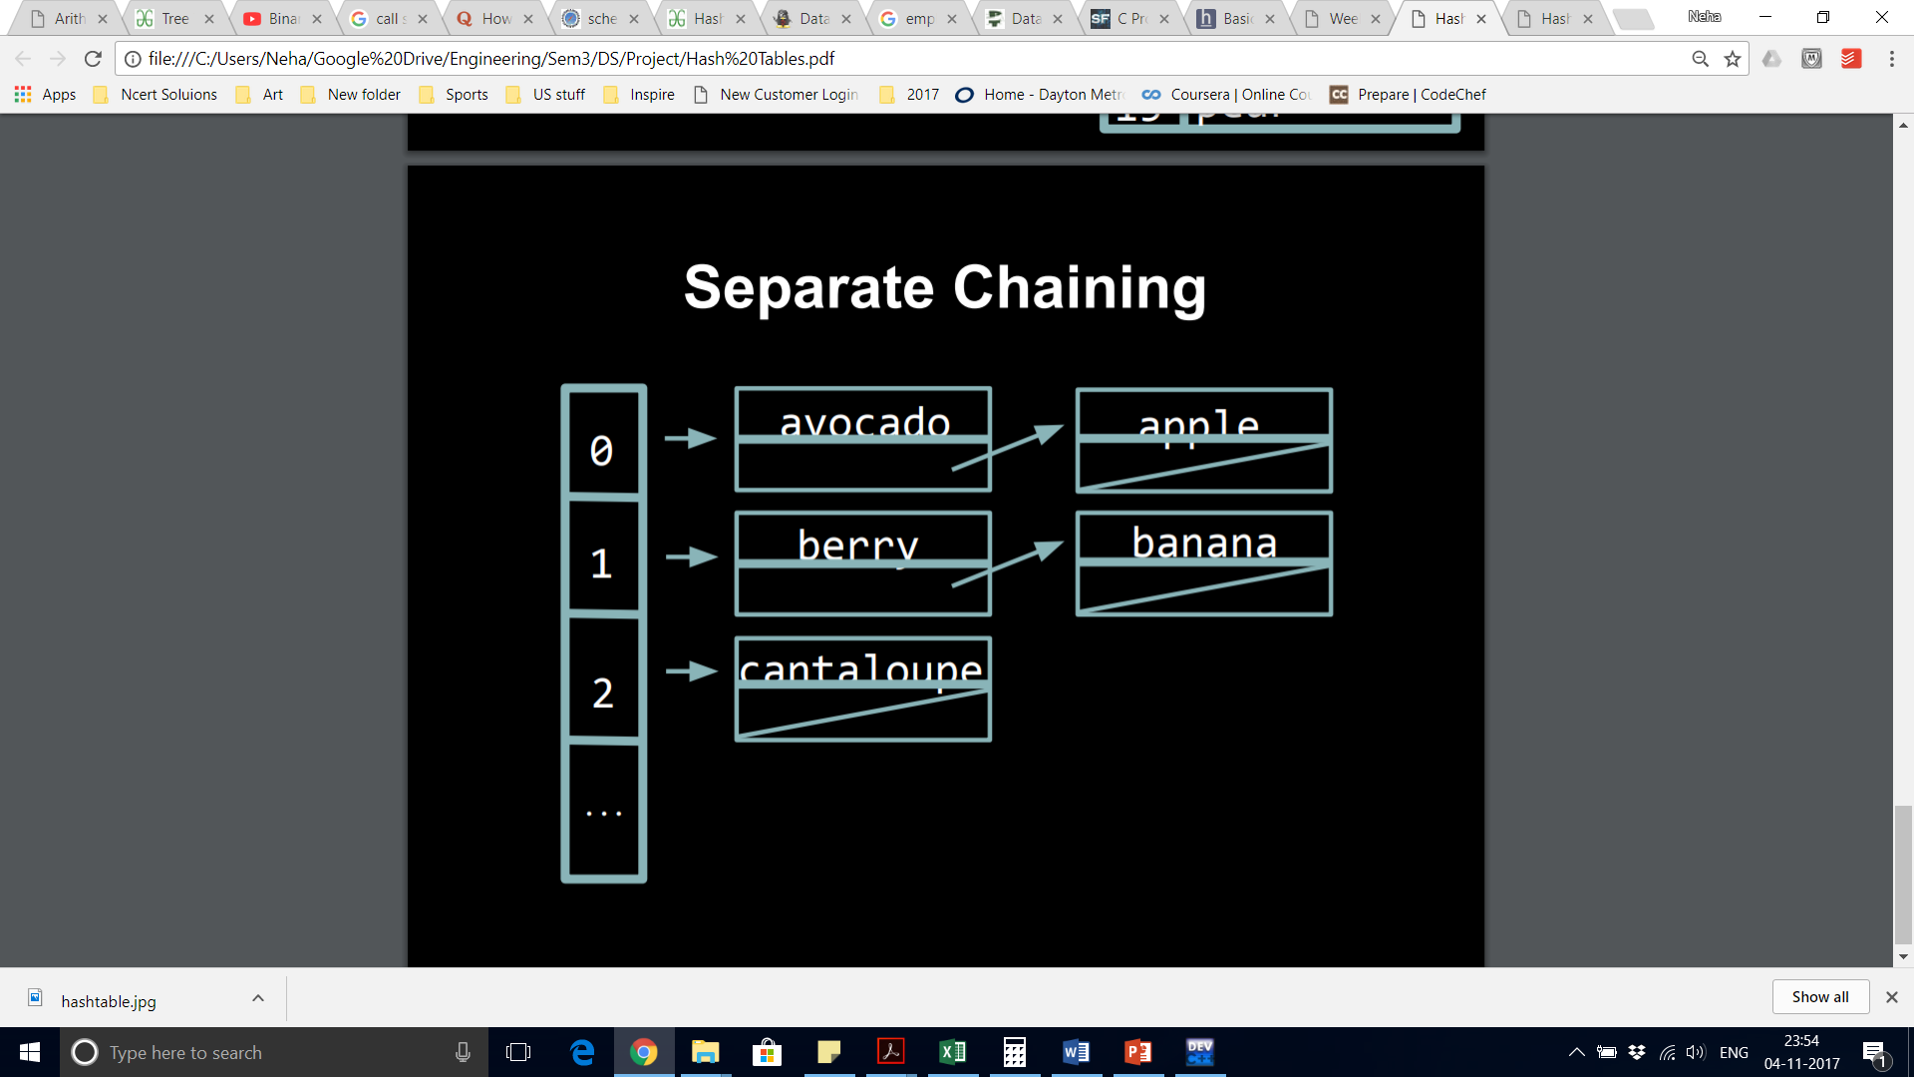
Separate chaining

Slide 10
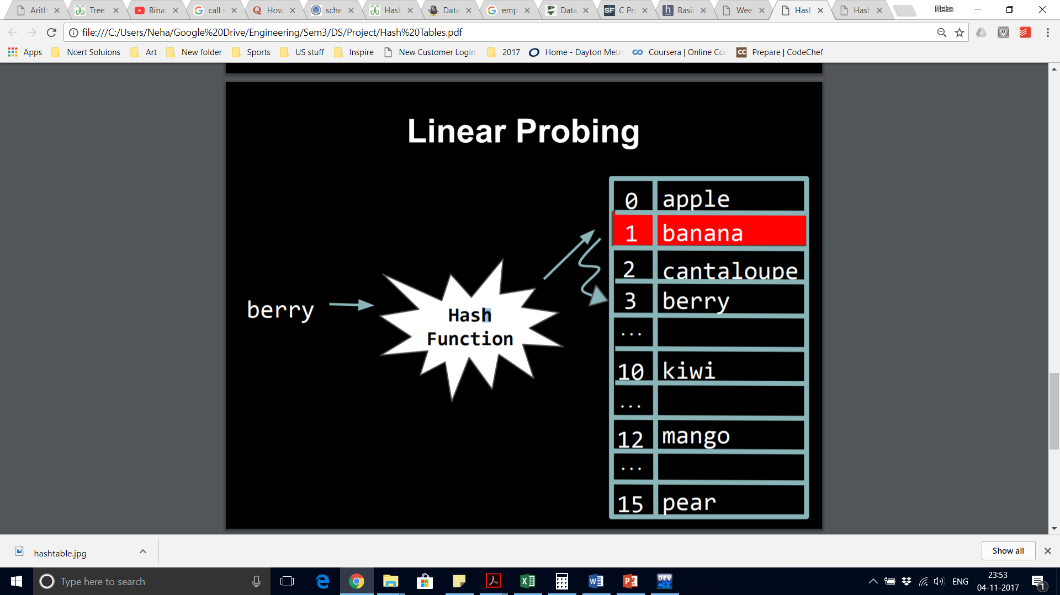
Linear probing

Slide 11
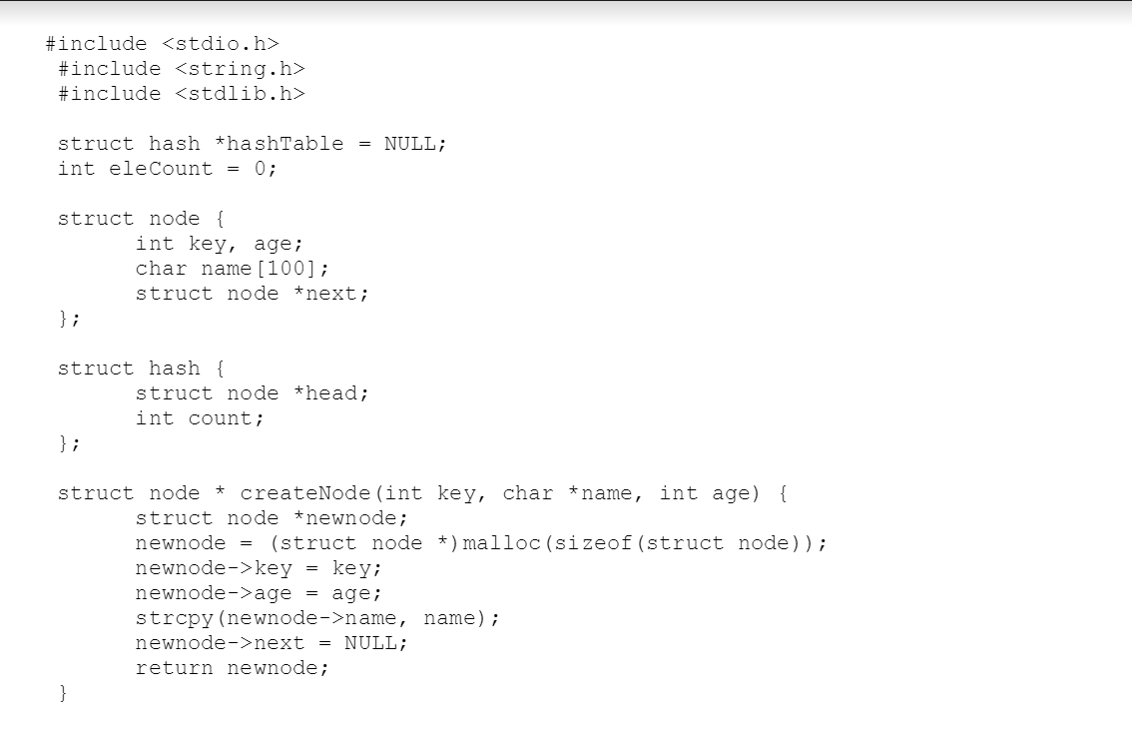
code

Slide 12
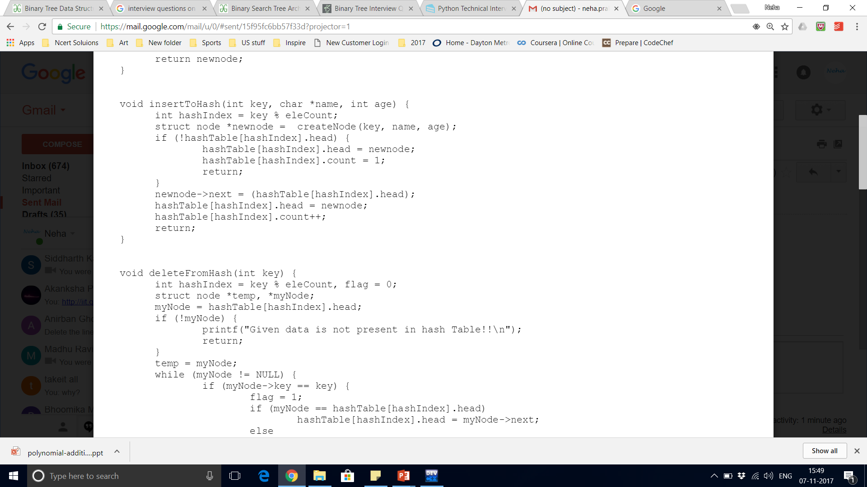
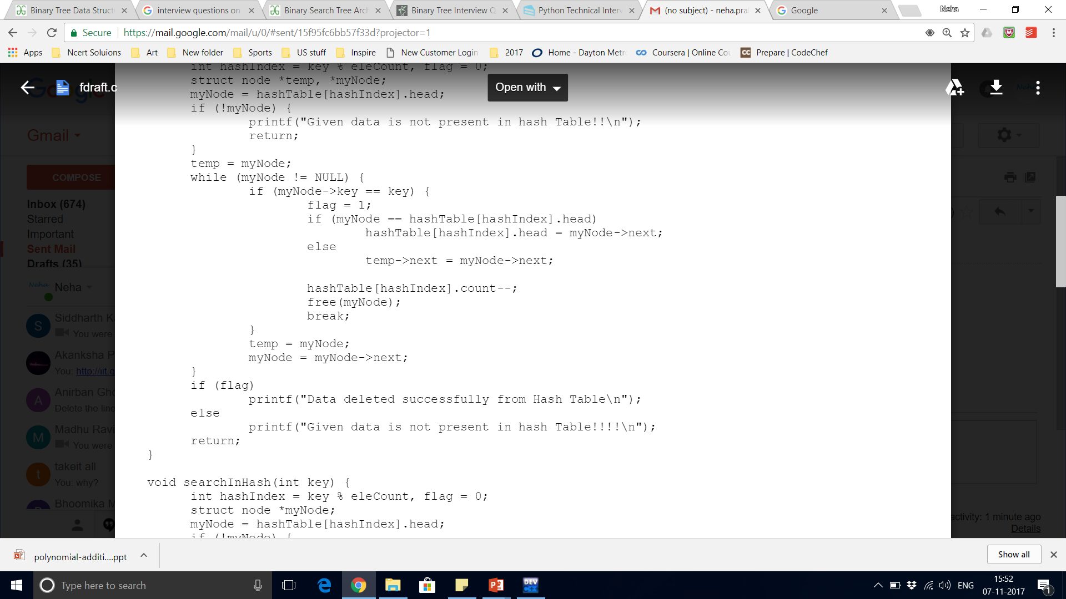

Slide 13
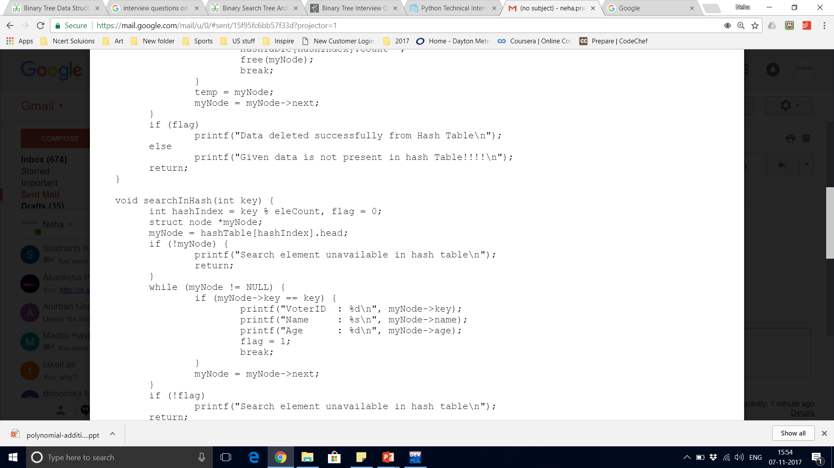
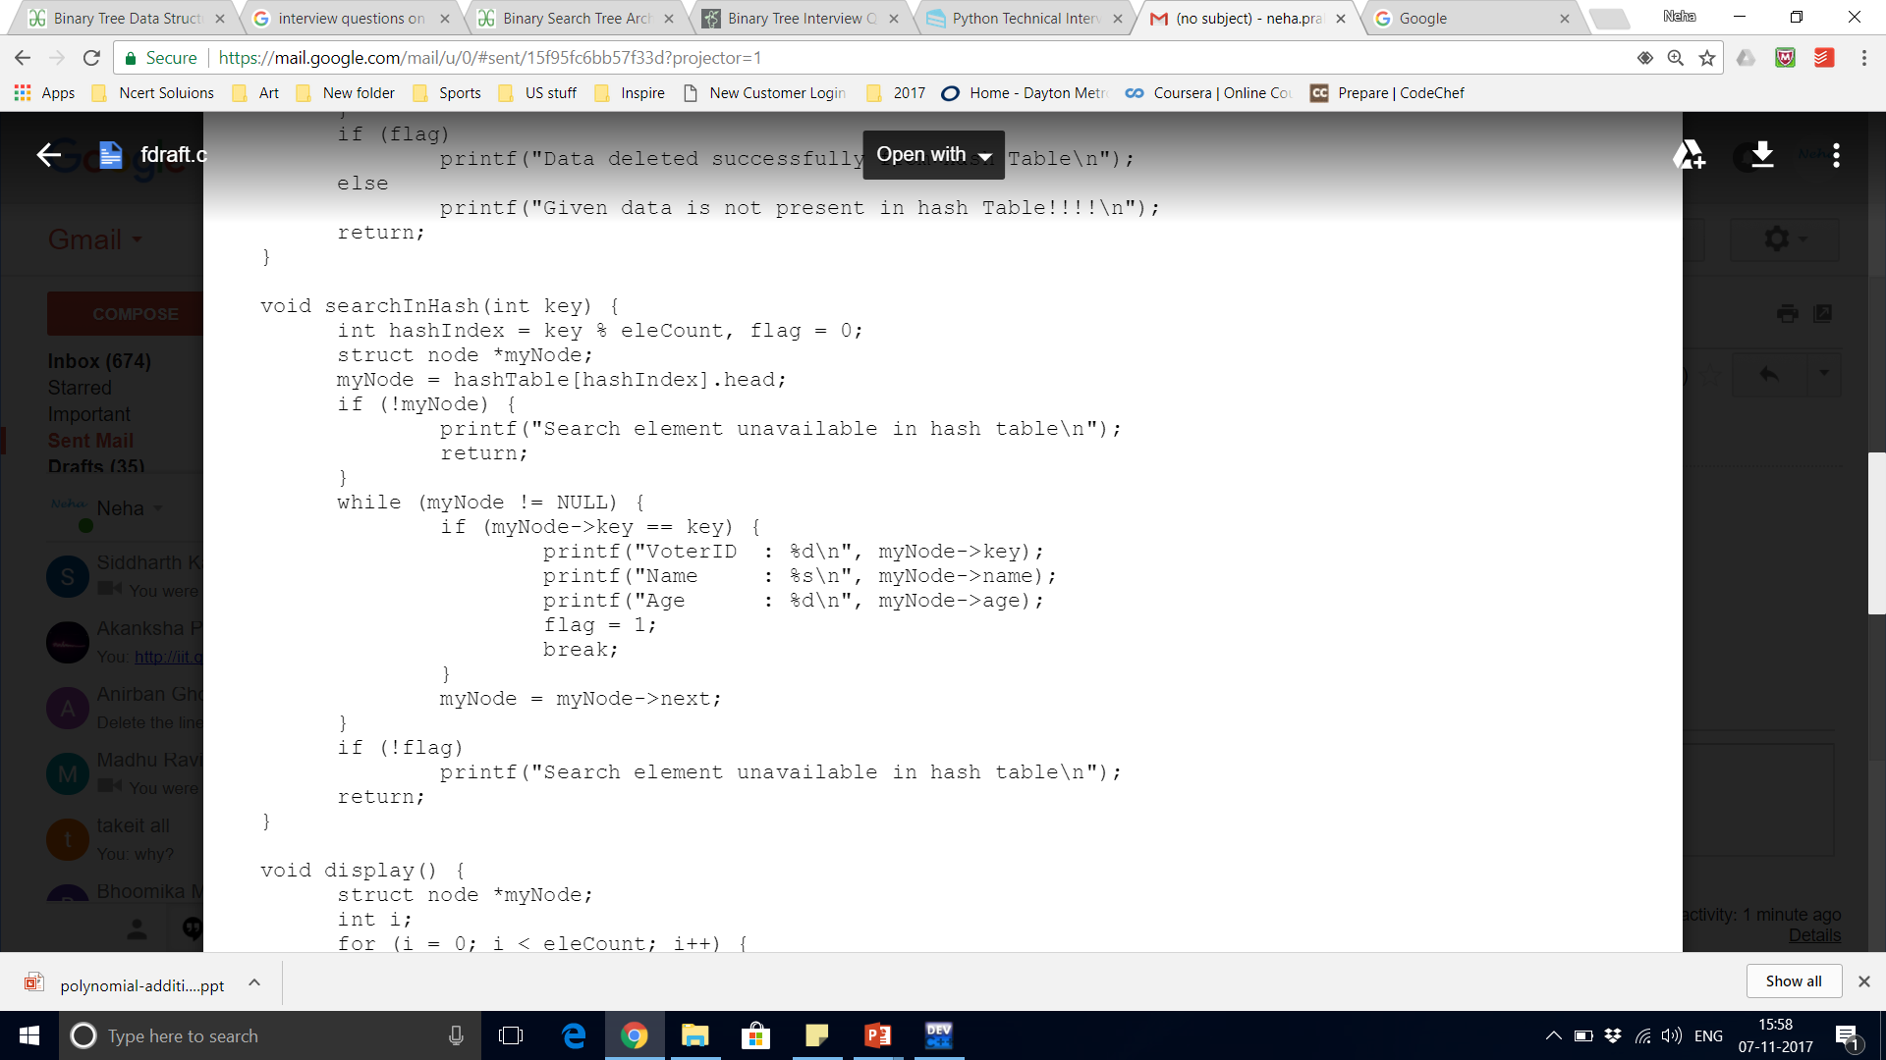

Slide 14
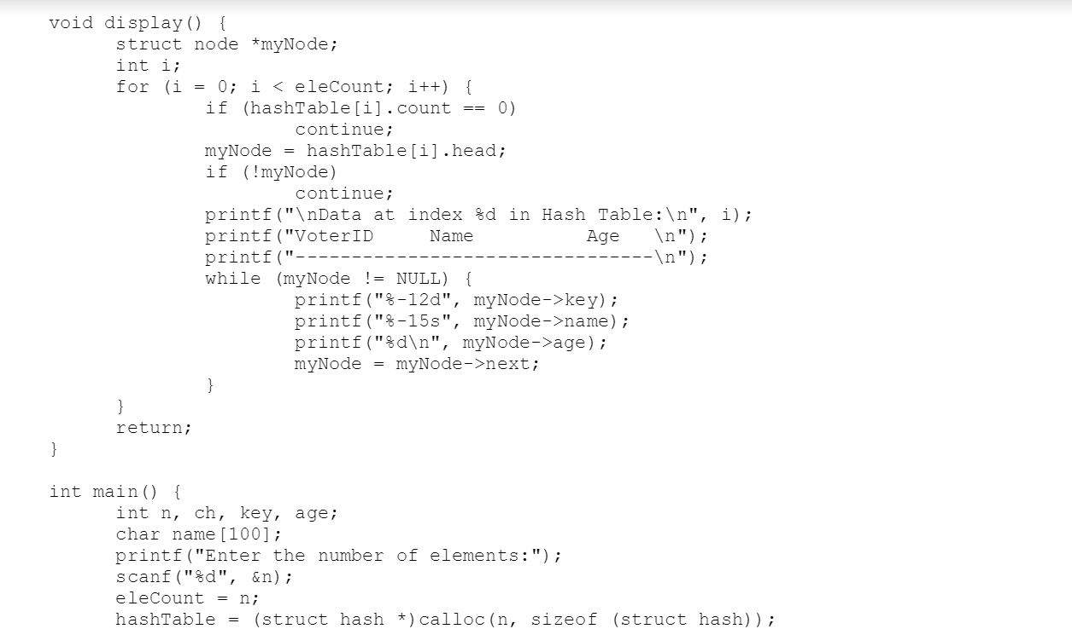

Slide 15
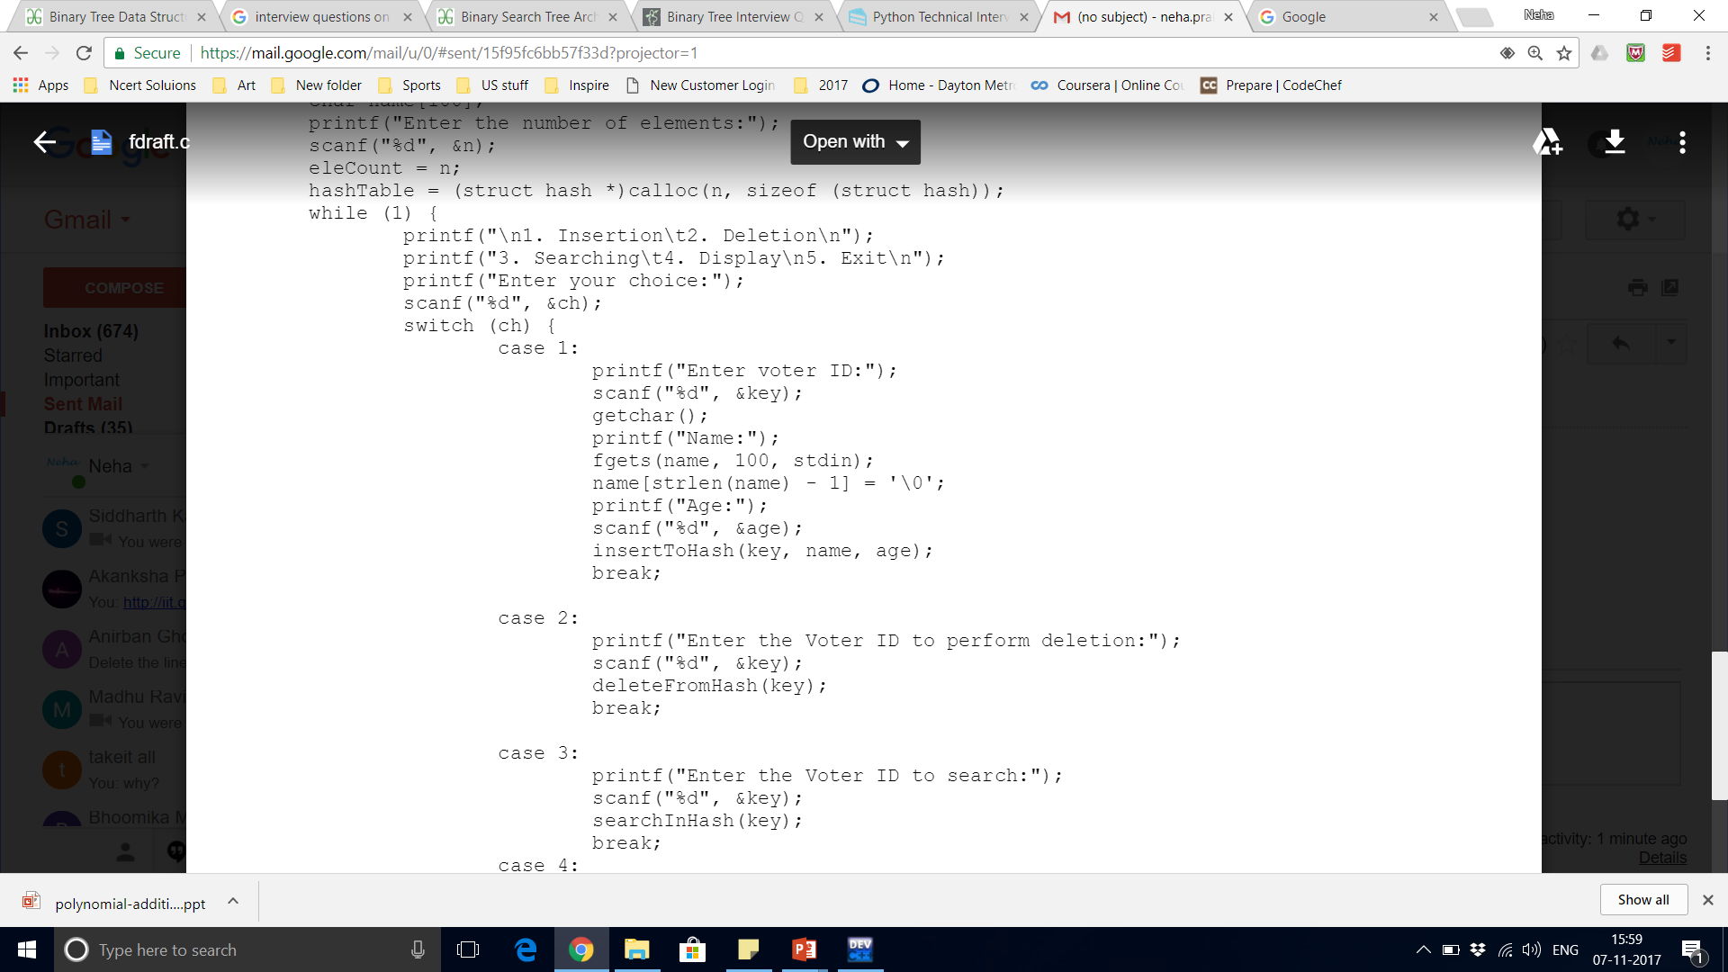
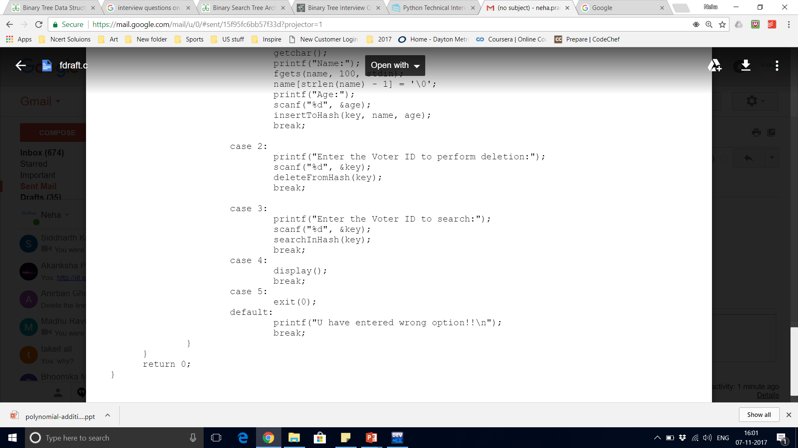

Slide 16
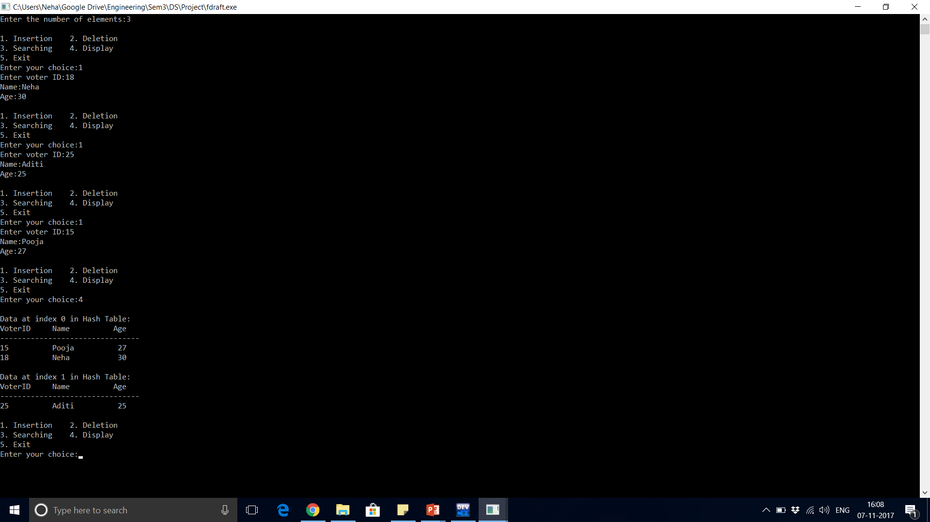
output

Slide 17
Disadvantages of separate chaining
Wastage of space – Some parts of the hash table were never used.
If the chain becomes too long, then the search time can become O(n) in worst cases.
Uses extra space for links.

Slide 18
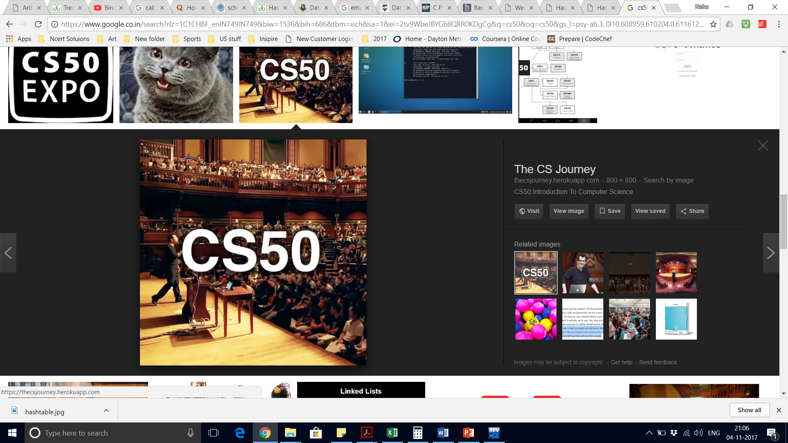

Sources

Slide 19

Thank you

